Slide 1
Automated Scientific Knowledge Extraction AMIDOL
Eric Davis, Alec Theriault, Ryan Wright
https://github.com/GaloisInc/AMIDOL/
This research was supported by the ASKE program under
DARPA-PA-18-02-AIE-FP-039

Slide 2
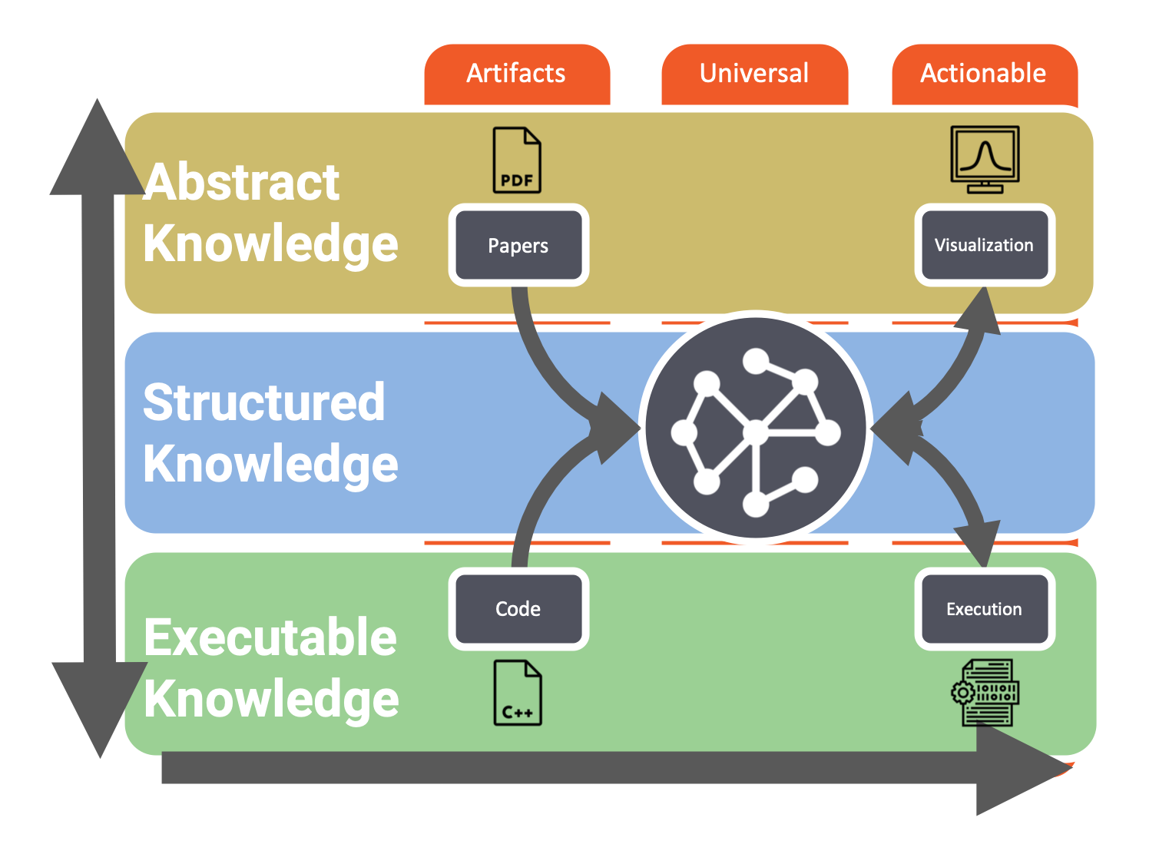


Integrated Prototype
Collaboration with our colleagues at Arizona and GTRI
Integrated prototype to read models from code, with groundings, infer VDSOLs, and transform models.

Slide 3
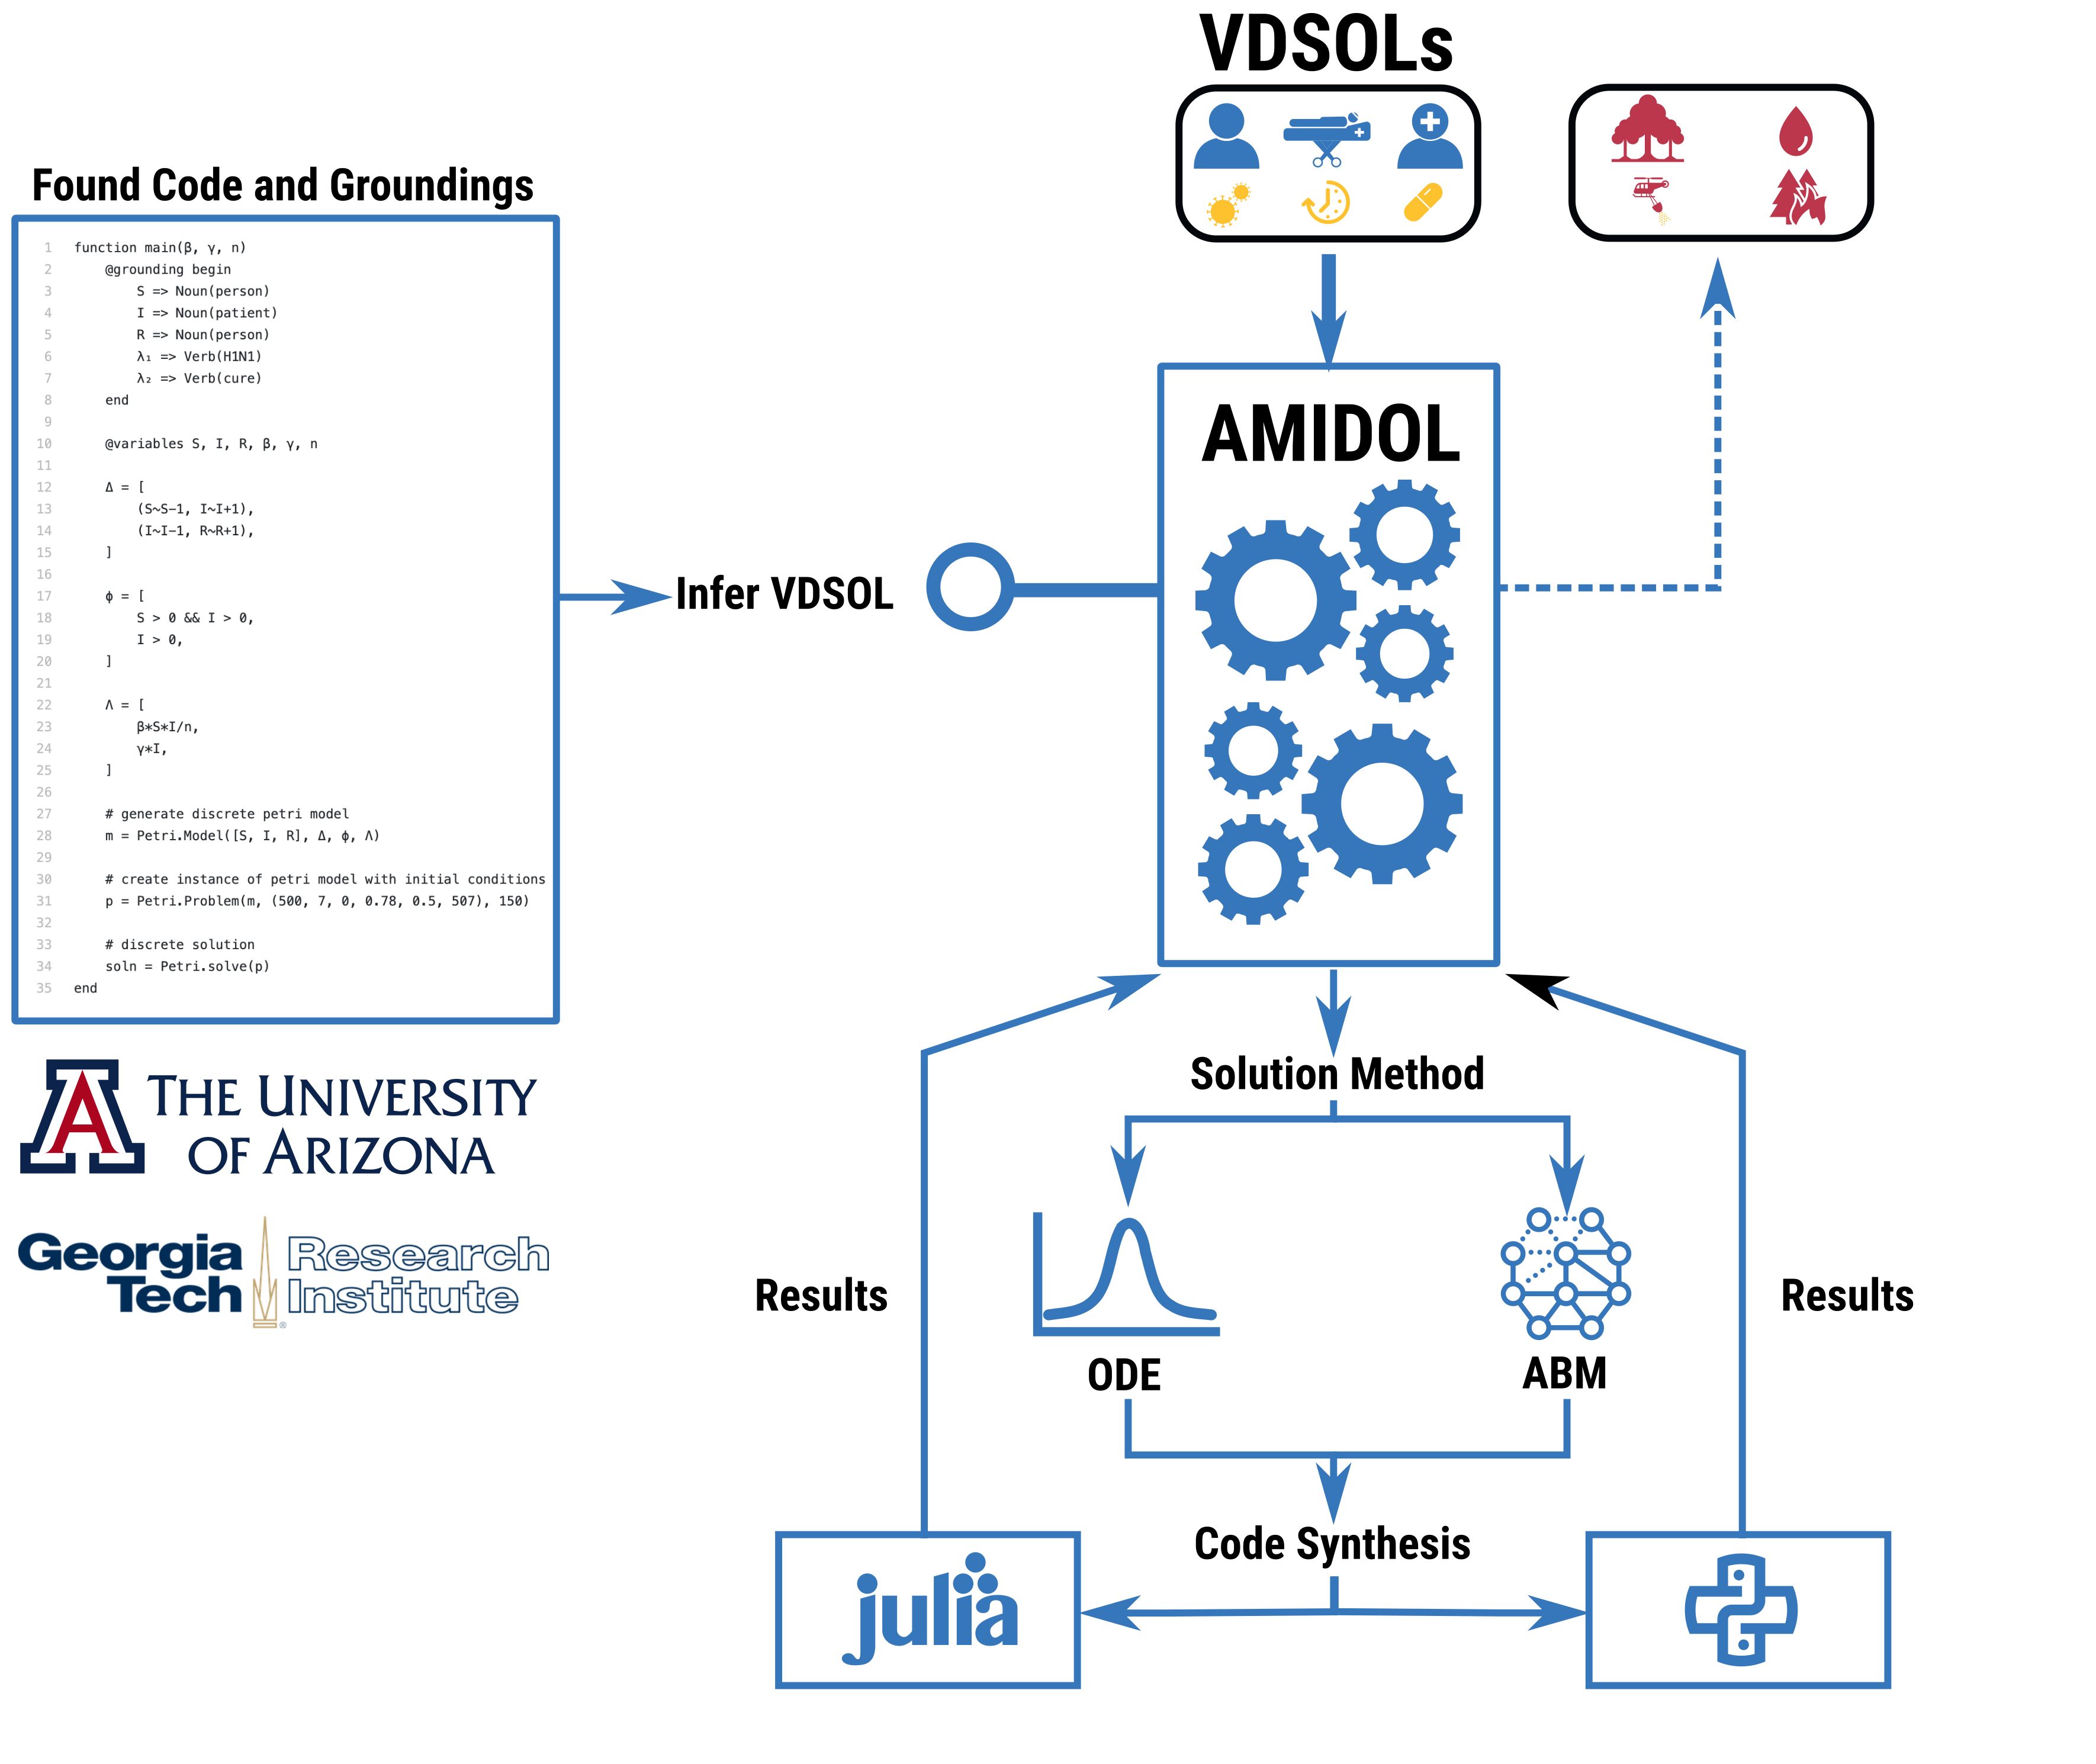
AMIDOL – Recent Advancements
Through our collaboration with UArizona and GTRI:
Developed an API to infer VDSOLs from extant code and groundings.
AMIDOL has the ability to pair code and groundings with a domain ontology.
The ontology is annotated with a model signature.
Allows AMIDOL to infer a VDSOL palette with limited human-machine teaming.

Slide 4
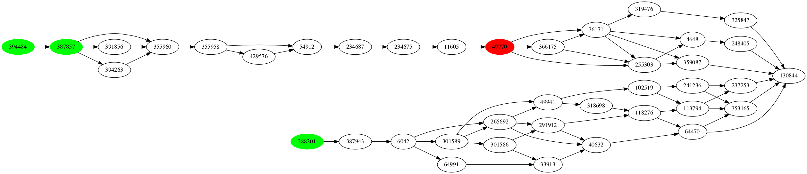
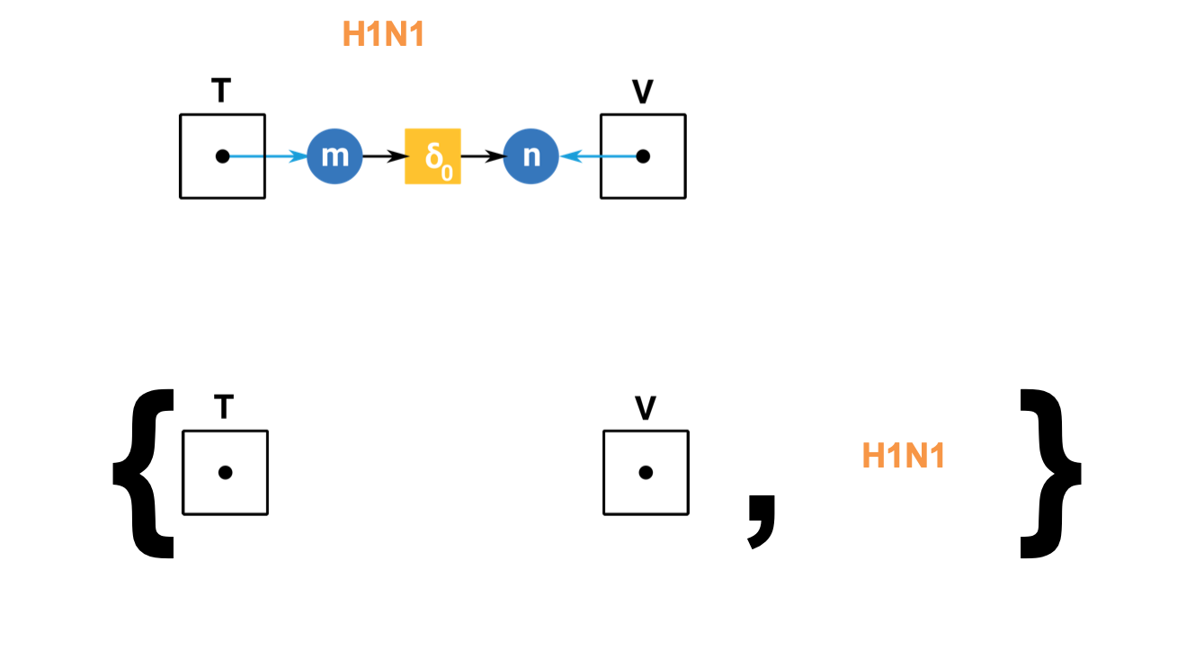
Formulation Inference: Ontology Binding
Attempt to bind Structured Knowledge representations to new palette elements, forming Abstract Knowledge representations.
Completely decorated ontology element, ”virus (organism)”
H1N1 (organism)
H1N1 Vaccine

Slide 5
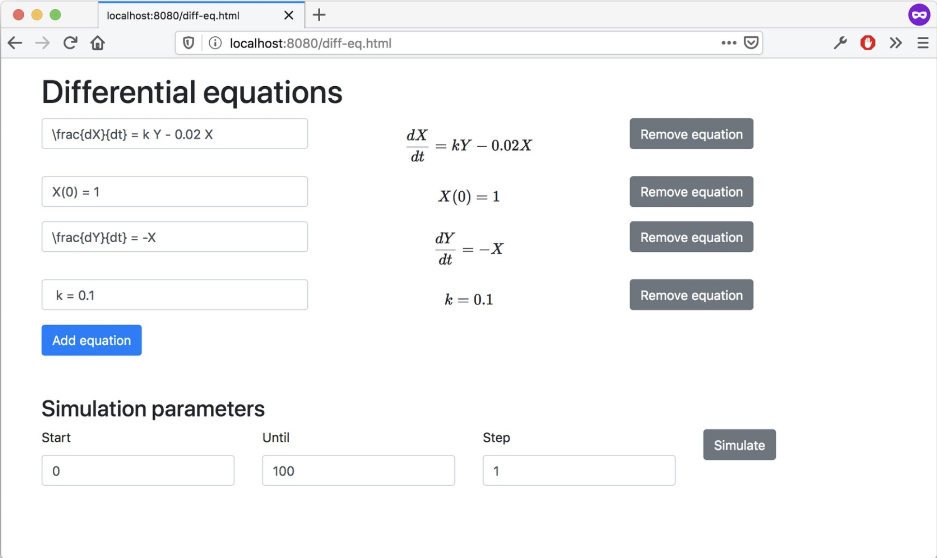
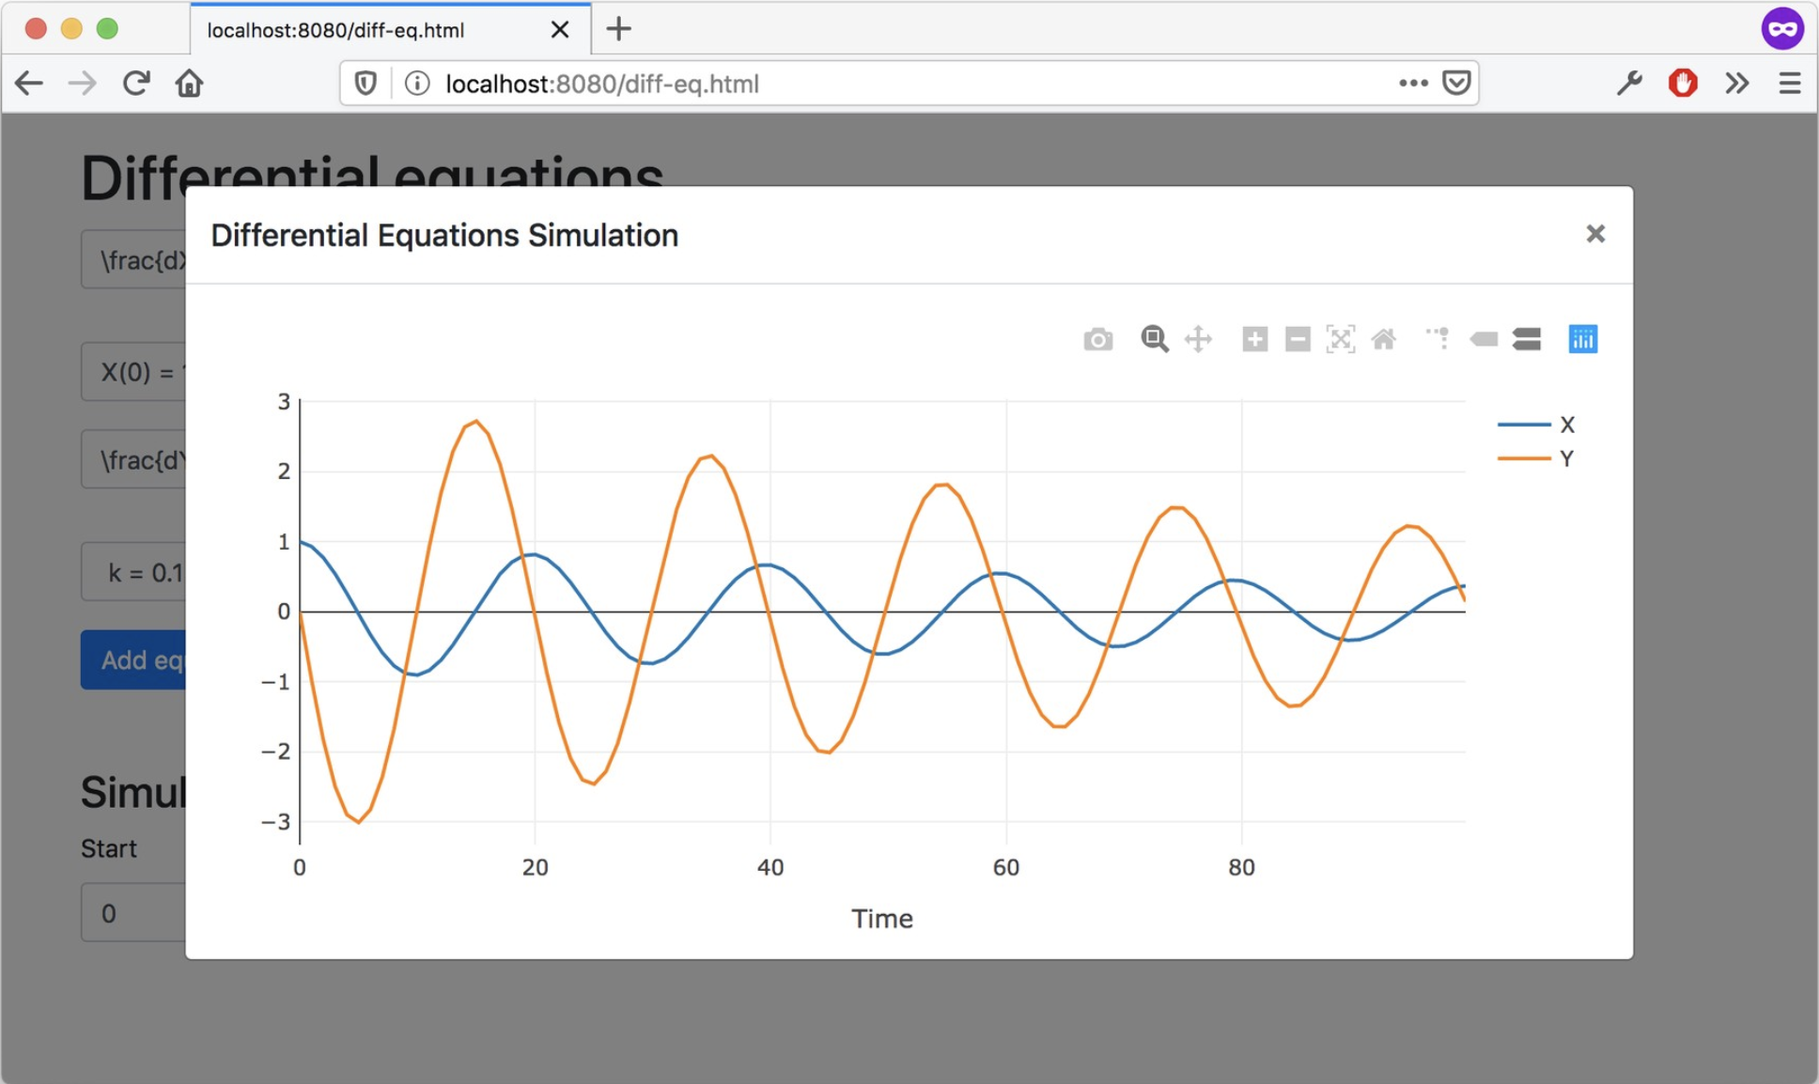
VDSOL Improvements – Differential Equations
Further extended VDSOLs to support equations.
Users can input custom equations into AMIDOL representing:
Initial conditions
Constants
Differential equations
Can read differential equations from LaTeX source.
Represents an entirely new type of VDSOL, showing the flexibility of languages AMIDOL can support.

Slide 6
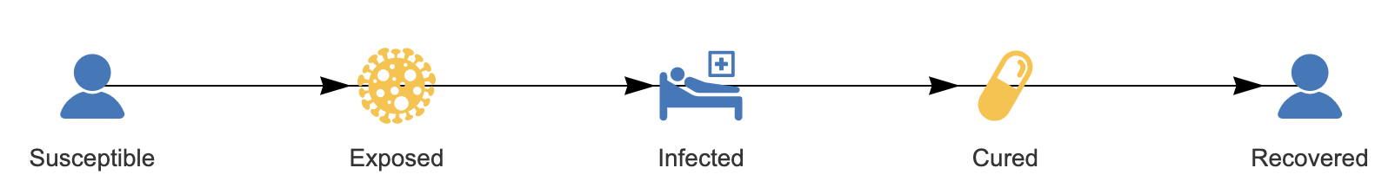
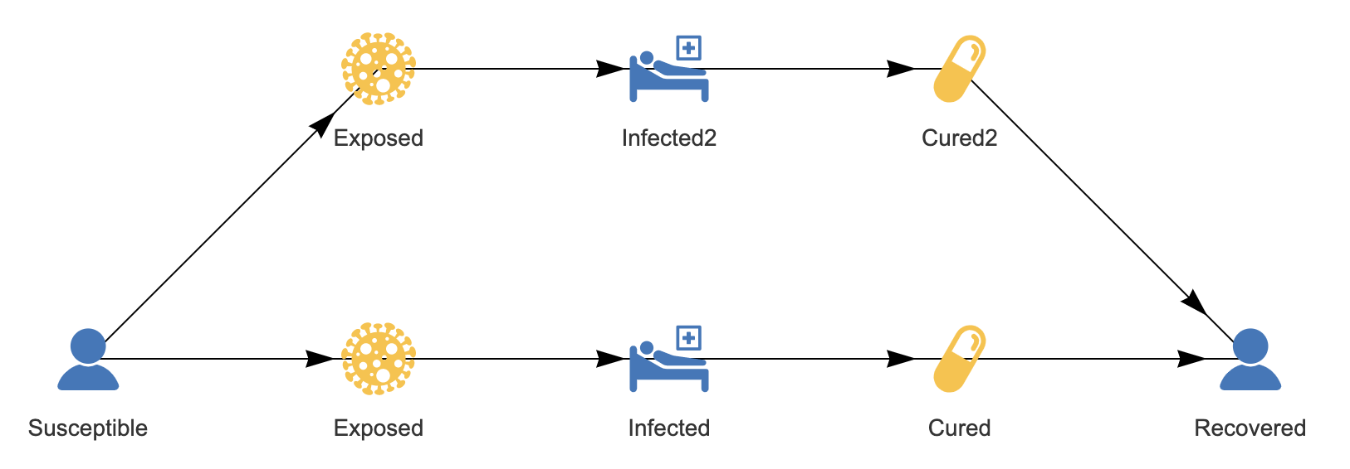
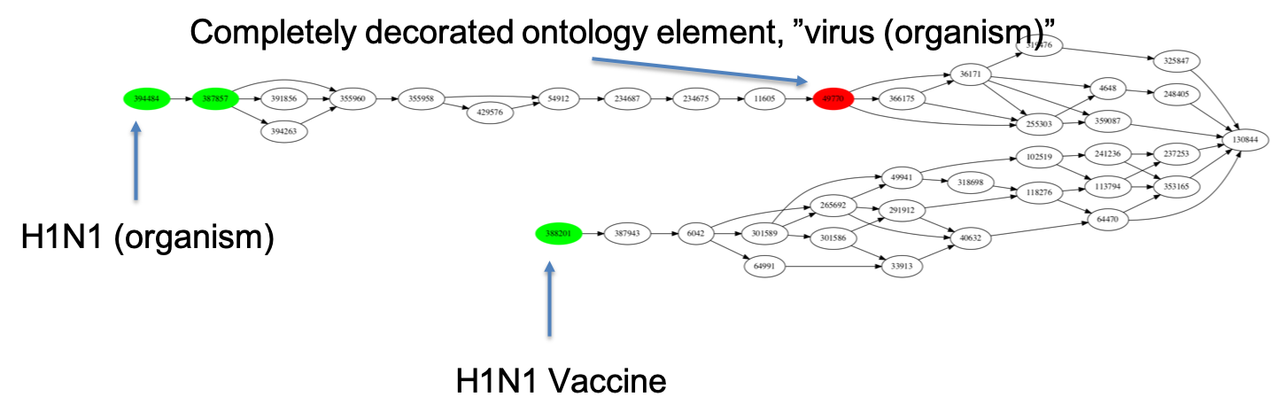
Knowledge Discovery and Curation
AMIDOL models are stored as:
VDSOLs: Abstract Knowledge Layer formulations to allow scientists to interact directly.
Process Algebras: Structured Knowledge Layer models in universal forms for curation and transformation.
AMIDOL allows models and formulations to be connected to domain-specific ontologies, curating knowledge and relating it to semantic content.

Slide 7
How do we help leverage AMIDOL for all of ASKE?

Slide 8
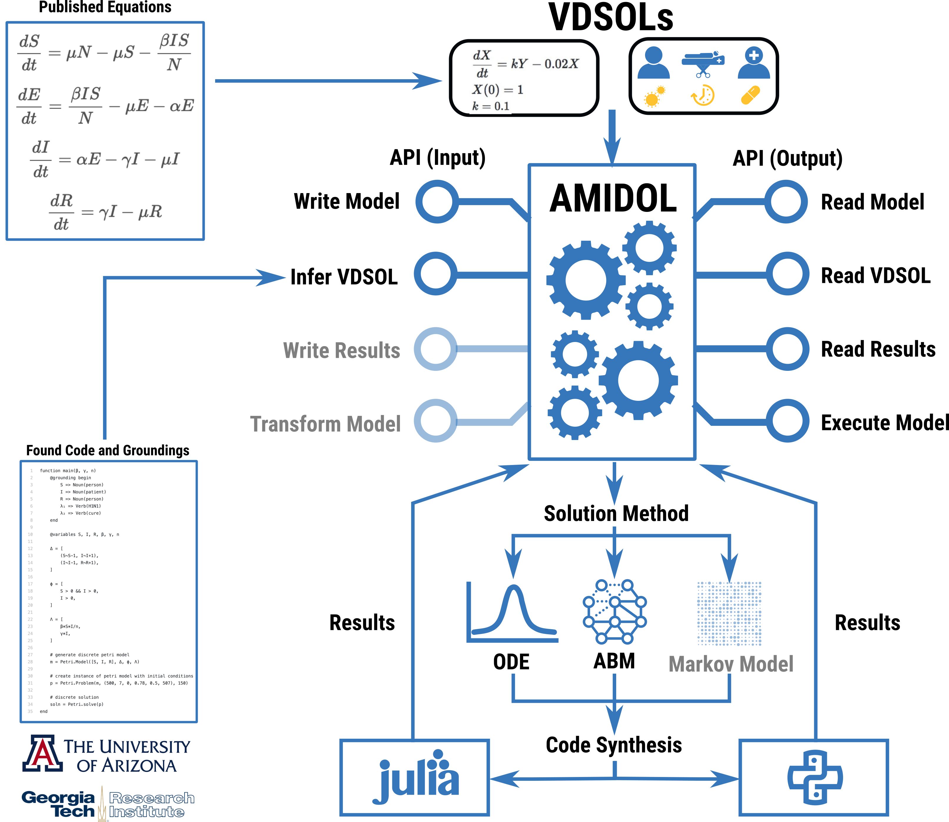
AMIDOL – Recent Advancements
The AMIDOL API
Allows external programs to use AMIDOL as part of an integrated prototype.
Allows AMIDOL to be used as a modeling service.
External programs/services can interact by:
Reading/writing models
Reading/writing/infering VDSOLs
Reading/writing results
Transforming/executing models
Provides a way to engage with users using AMIDOL.
Provides a way to call AMIDOL’s solution logic and compiler/code synthesis engine.

Slide 9
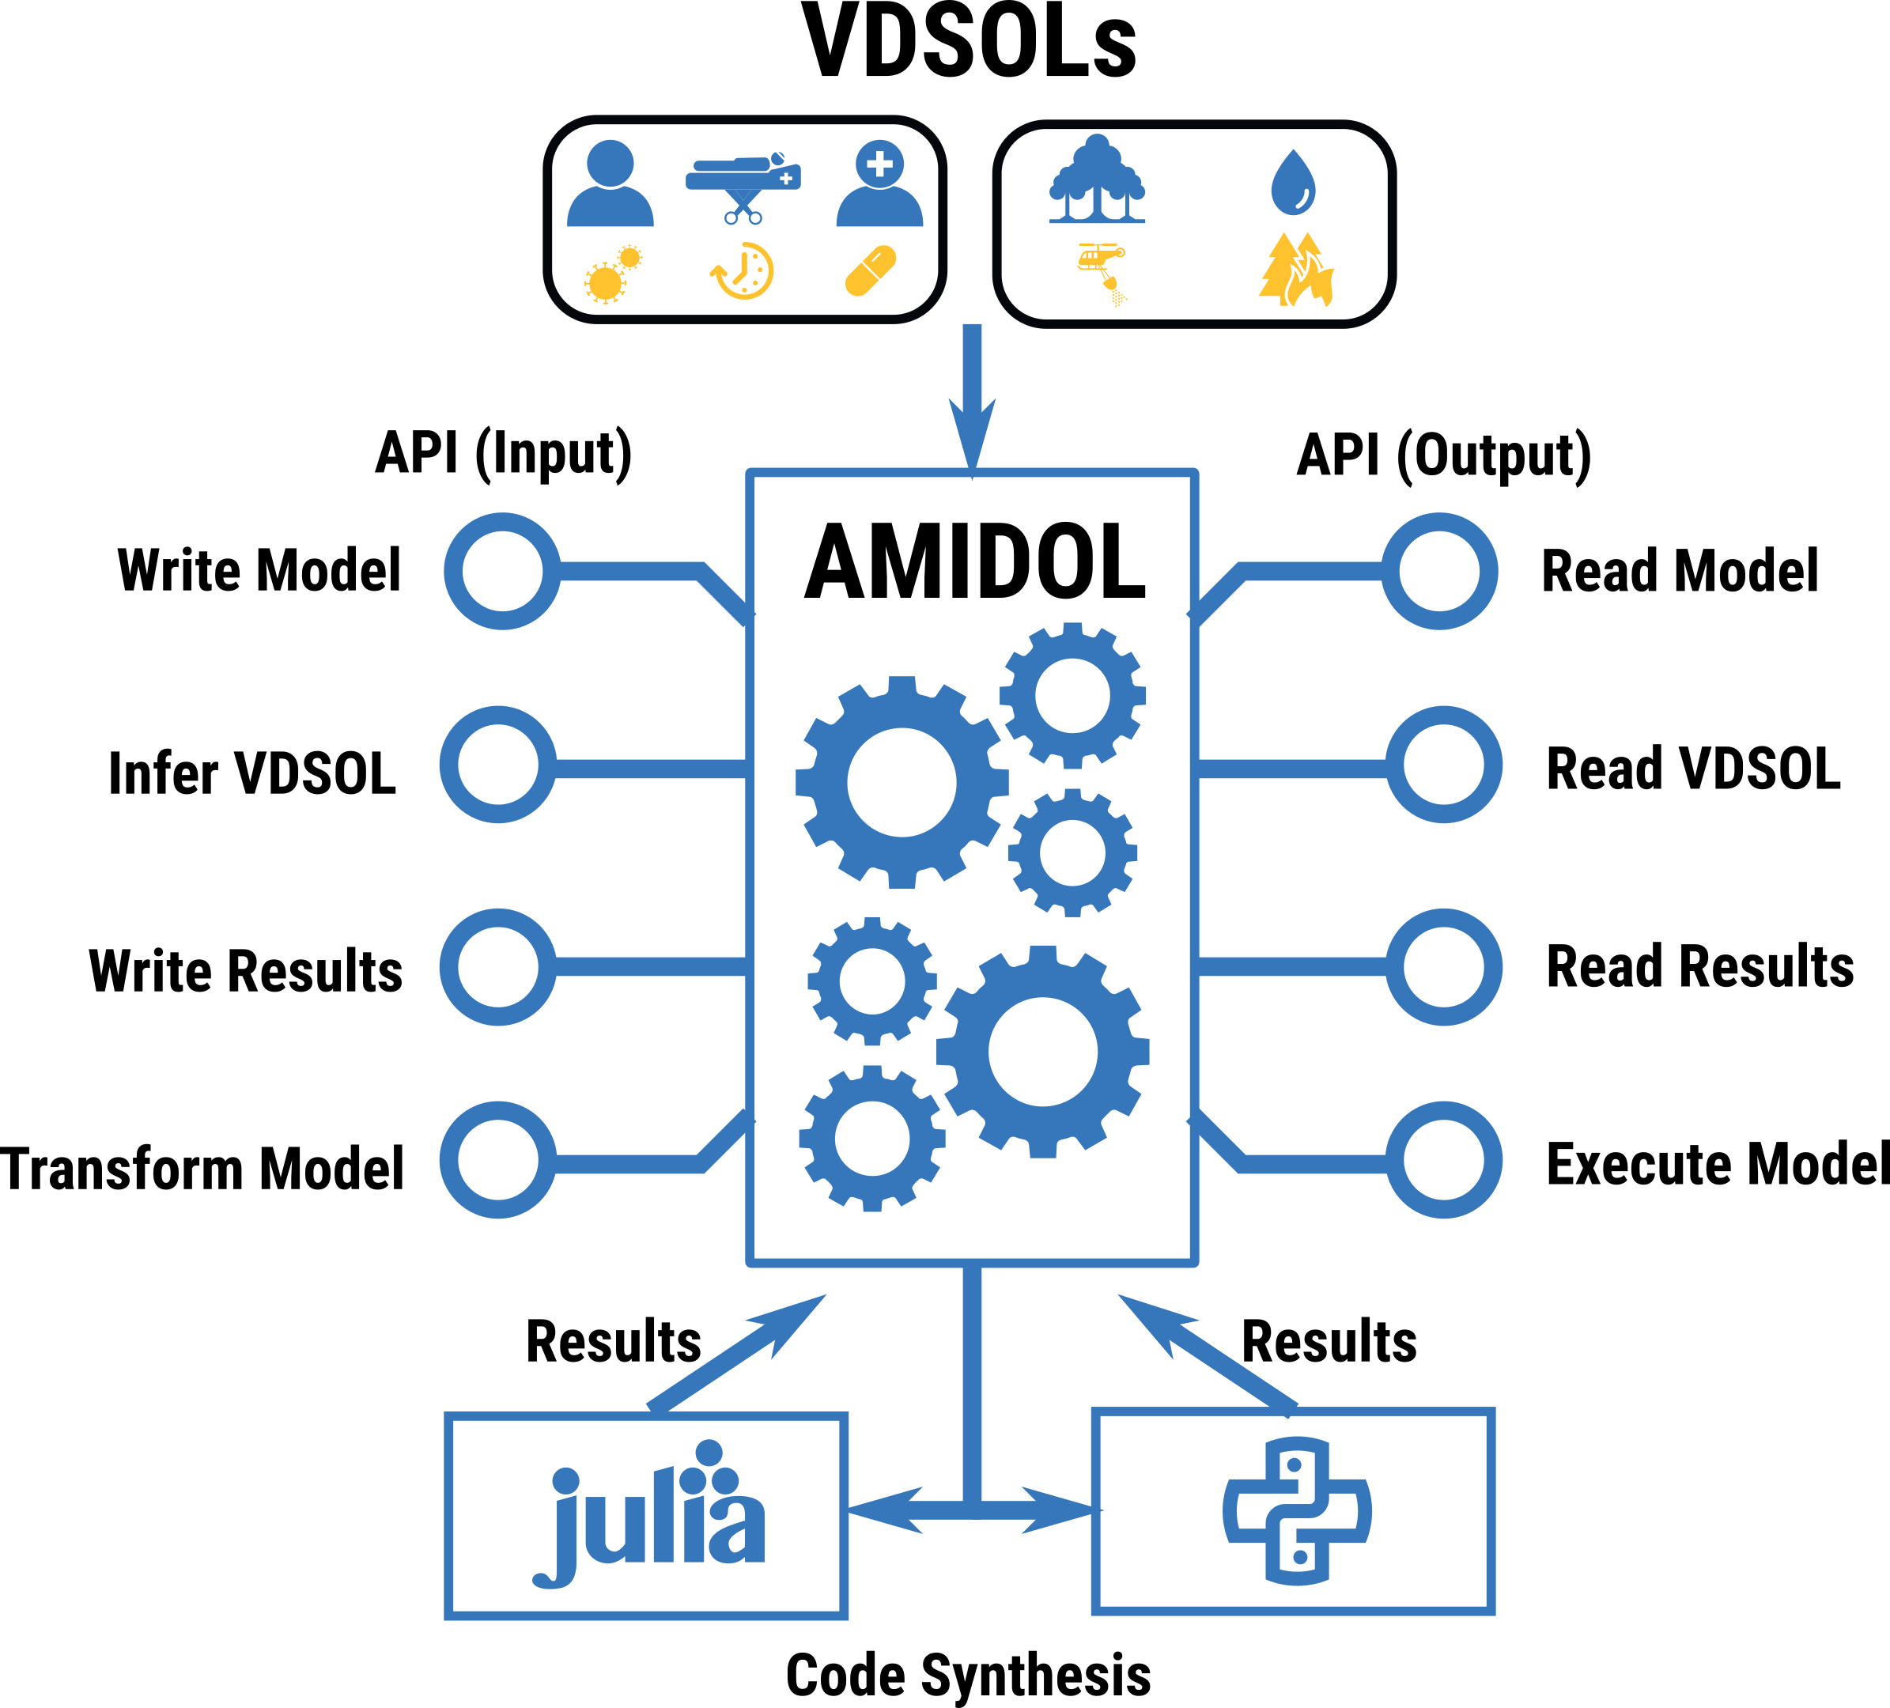
Constructing, Transforming, and Sharing Models
AMIDOL API
AMIDOL API allows for tools/projects to access AMIDOL as a service.
Already implemented in part with Arizona and GTRI.
Soon to be available as part of our open source tool.

Slide 10
Read/Write Model
Summary – Allow external applications to read and write models to AMIDOL’s IR.
Requirements – Working to supplement AMIDOL with searchable model database, supporting a query interface for model properties and UUIDs for models.

Slide 11
Infer/Read VDSOL
Summary – Currently supports VDSOL inference from AMIDOL IR or Julia code with groundings.
Requirements – Allows retrieval of VDSOLs by UUID and query interface for VDSOL properties.

Slide 12
Read/Write Results
Summary – Allow external applications to read and write to the AMIDOL results database.
Requirements – AMIDOL is implementing a graph-based results database, including mechanisms to index into the database to write external results (from “data” or an “external model”).
Suggestions – Measure indexing by outside applications is an open question. We need a clear definition of measure equivalence. What does it mean for two measures to be the same? At a basic level, they have the same sigma-algebraic structure, over borel sets that are proxies for the same space. What does this mean in practice?

Slide 13
Transform/Execute Model
Summary – Allow external applications transform a model in AMIDOL, and to execute a model in AMIDOL.
Requirements – Valid transformation set. This is essentially a model transformation algebra.

Slide 14
Model Transformation Algebra

Slide 15
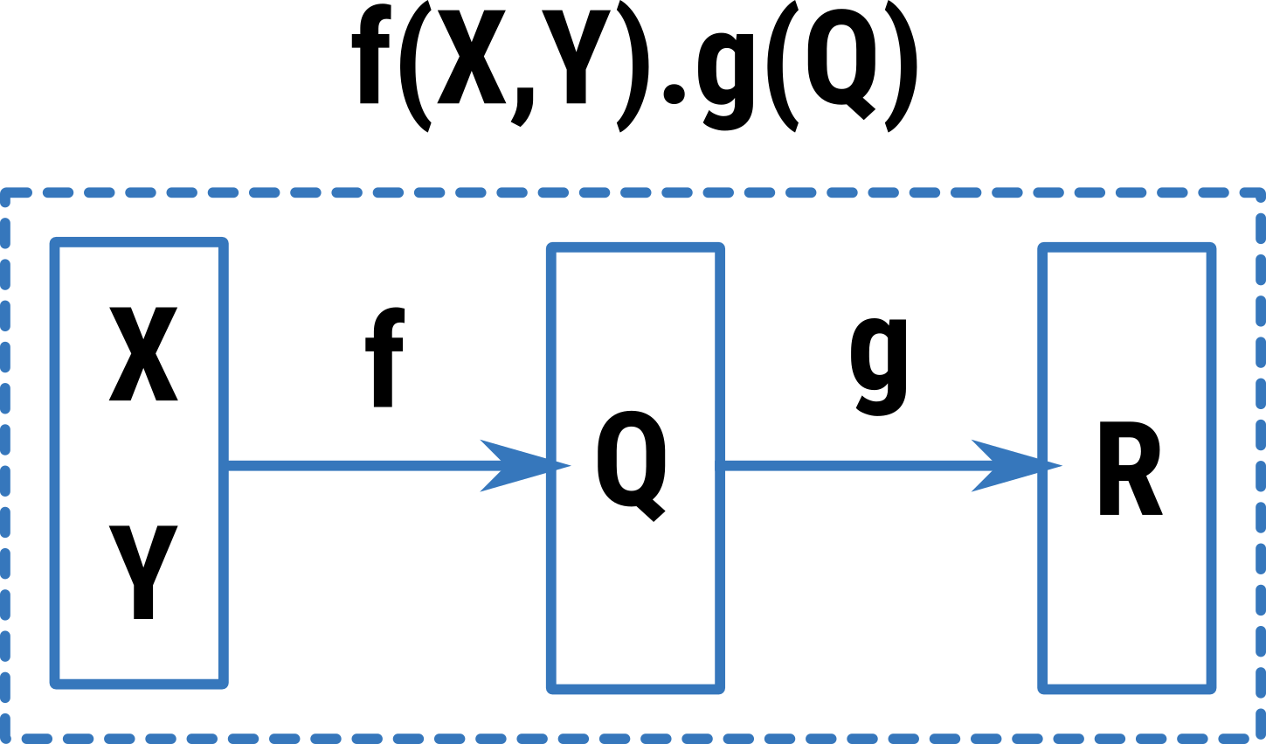
Model Transformation Algebra
Models form a group with the operation ”.” (serial composition).
Closed
Associative
Identity element
The “pass through” model which immediately yields its inputs without changing them.
Inverse element is a bit harder.
Intuitively you need a model which ”undoes” g() yielding no output, and passes through the inputs to f().

Slide 16
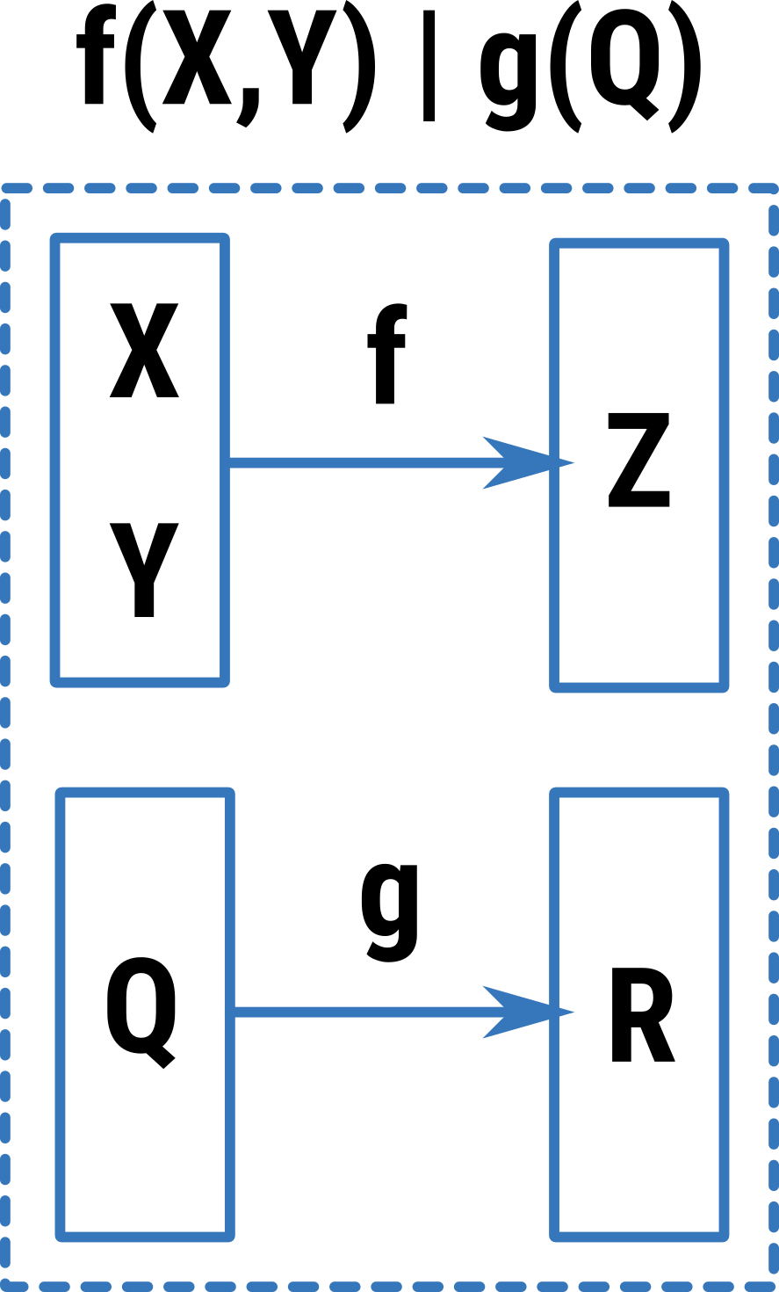
Model Transformation Algebra
Models also closed and associative with the operation ”|” (parallel composition).
Has a multiplicative identity
The “null” model.

Slide 17
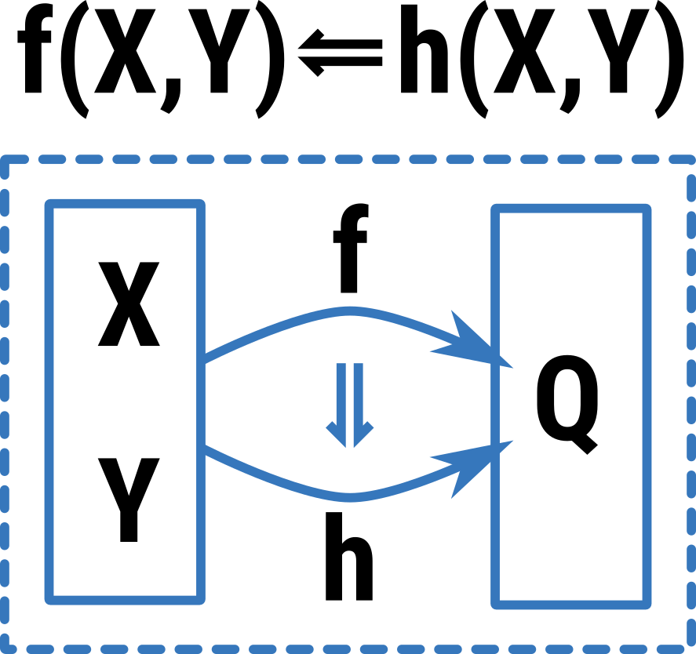
Model Transformation Algebra
Models also closed with the “⥢” operation (substitution):
Creates a bi-category relationship.
Used to replace models with “compatible signatures”.

Slide 18
Model Transformation Algebra
Initial Model Transformation Algebra: (M, ., |, ⥢)
Allows for the definition of model composition and transformation in a rich algebraic syntax that is closed over models.
Users can combine models across domains, allowing them to generate novel models, and explore novel hypotheses.
E.g. combining influence models and epidemiological models to explore infections over populations of cities which share commuter traffic.

Slide 19
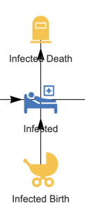
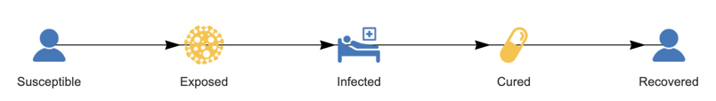
Allows Compositional Modeling
Vital dynamic model:
v(P)
SIR model:
f(S,I,R)
(v(P) | v(P) | v(P)).f(S,I,R)
Allows researchers to design models piece wise, reuse work, and share knowledge.
Resulting models should be translatable to VDSOLs using groundings using our prior developed inference procedures.

Slide 20
Measure Algebras and Results dB

Slide 21
Measure Algebras
AMIDOL is further enabling scientists to test hypotheses through algebras over measures.
Measures and data can be combined, subtracted, etc, tracking their type and provenance to form new measures.
n₀
d
r
r
M₀
+
+
M₁
??
r
r
n₁
d

Slide 22
Measure Algebras
AMIDOL utilizes a graph-based results database:
Stores results and data indexed by model (M) and measures (n).
Allows for automated hypothesis testing, model validation, model fitness.
Allows for model comparison, ranking, and prognostics and diagnostics.
Automated model-space exploration.
n₀
d
r
r
M₀
M₁
??
r
r
n₁
d

Slide 23
Measure Algebras
Currently using traditional algebra of real numbers.
Restriction: Type and unit checking. Requirements of formulas.
E.g. Chi-squared requires the underlying data to be normally iid distributed.
n₀
d
r
r
M₀
M₁
??
r
r
n₁
d

Slide 24


Model/Measure Algebras
Models can be combined with measure definitions to yield new models.
Changes what the synthesized code will solve for.
Allows for model reuse, exchange, and importing models without their measures to improve efficiency.
Optimize out parts of the model that cannot impact measures.
⊗
⊗

Slide 25




Model/Measure Algebras
Models can be combined with measure definitions to yield new models.
Changes what the synthesized code will solve for.
Allows for model reuse, exchange, and importing models without their measures to improve efficiency.
Optimize out parts of the model that cannot impact measures.

Slide 26
Model/Measure Algebras
Models can be combined with measure definitions to yield new models.
Changes what the synthesized code will solve for.
Allows for model reuse, exchange, and importing models without their measures to improve efficiency.
Optimize out parts of the model that cannot impact measures.
>>

Slide 27
Initial Performance Benchmarks
 | Model | SIR | SIIR | Predator-Prey | SIR w/ Vital dynamics
Time(s) | Graph VDSOL to IR compilation | 1.7ms | 1.7ms | 1.1ms | 1.6ms
 | Graph VDSOL to IR compilation | 1.8s – 6s | 2.1s – 6s | n/a | n/a
 | IR compilation to Python backend | 190ms | 160ms | 30ms | 160ms
 | IR compilation to Julia backend | 24ms | 25ms | 15ms | 52ms
 | Execution of Python backend output | 2.5s | 2.4s | 1.1s | 2.5s
 | Execution of Julia backend output | 9.8s | 12s | 7.5s | 7.0s
Lines of code | Python backend output | 40 | 45 | 39 | 47
 | Julia backend output | 44 | 62 | 51 | 60

Slide 28

Thank you! Questions? http://amidol.galois.com https://github.com/GaloisInc/AMIDOL/ ewdavis@galois.com
Notes:
Leaders in high assurance research and development
Creating trustworthiness in critical systems
Solving your hardest computer science problems

